Slide 1
Retail Store Analysis
SUBTITLE : Data Analysis Project
Name : Gokulnath E

Slide 2
Project Objective
Objective :-
The main goal of the project is to analysis a sales data for retail store and find insights.
To identify which product categories, generate the highest sales.
To find out which payment method customers prefer.
To analyze top customers based on their total spending.
To study monthly sales trends and seasonal changes.
To provide business recommendations for better growth.

Slide 3
Software Used for Analysis
Python
Pandas
Matplotlib/Seaborn
SQL
Tableau

Slide 4
Dataset Information
Total Records – 12,575
Column - Transaction ID, Customer ID, Category, Item, Price Per Unit, Quantity, Total Spent, Payment Method, Location, Transaction Date, Discount Applied.

Slide 5
Data Cleaning
Filled missing numerical values (Quantity, Price, Total Spent) with median.
Filled missing categorical/Boolean values with "Unknown" / False.
Converted columns to correct data types.
Removed extra spaces and standardized text for Category, Item, Payment Method, Location.
Checked and removed duplicate rows.

Slide 6
Data Visualization Charts & Dashboard

Slide 7
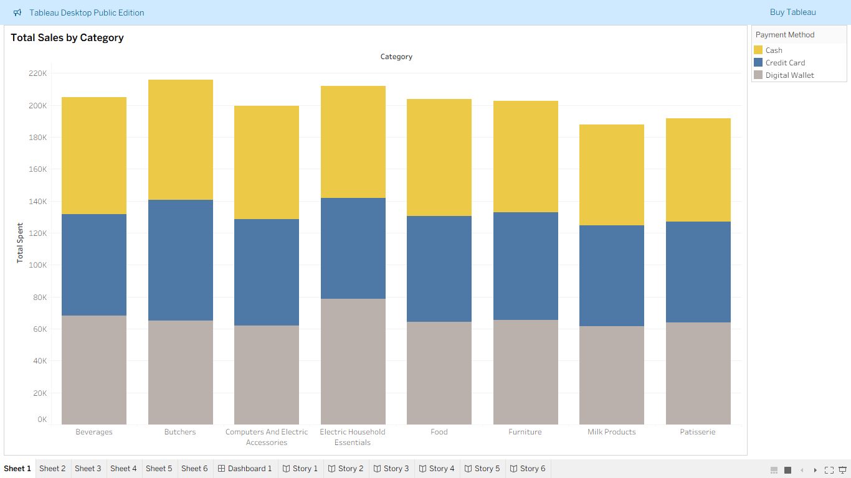

Slide 8
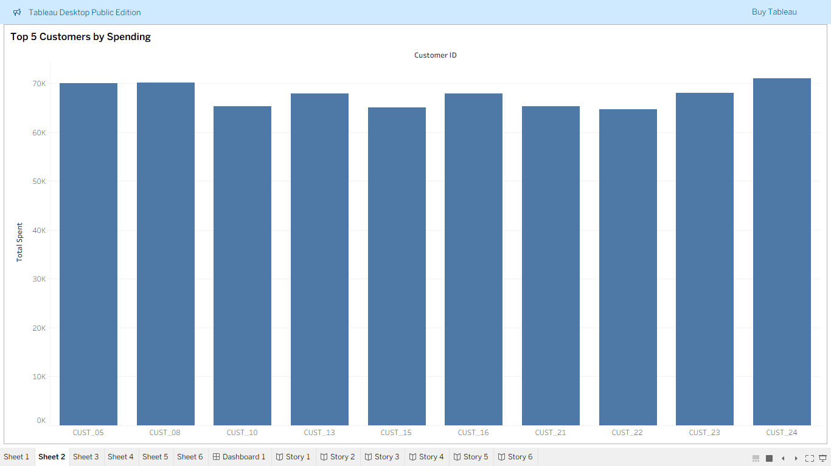

Slide 9
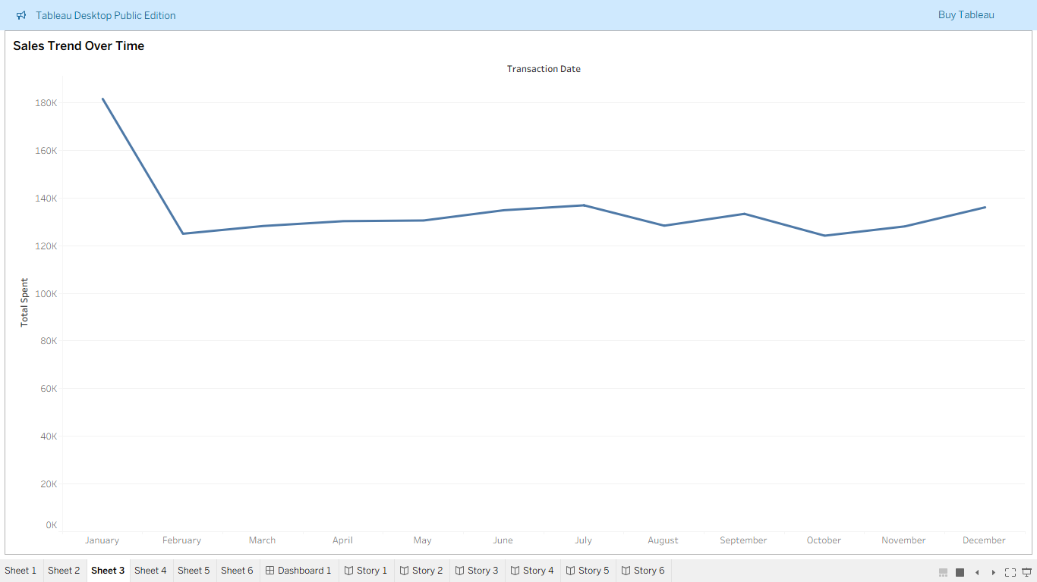

Slide 10
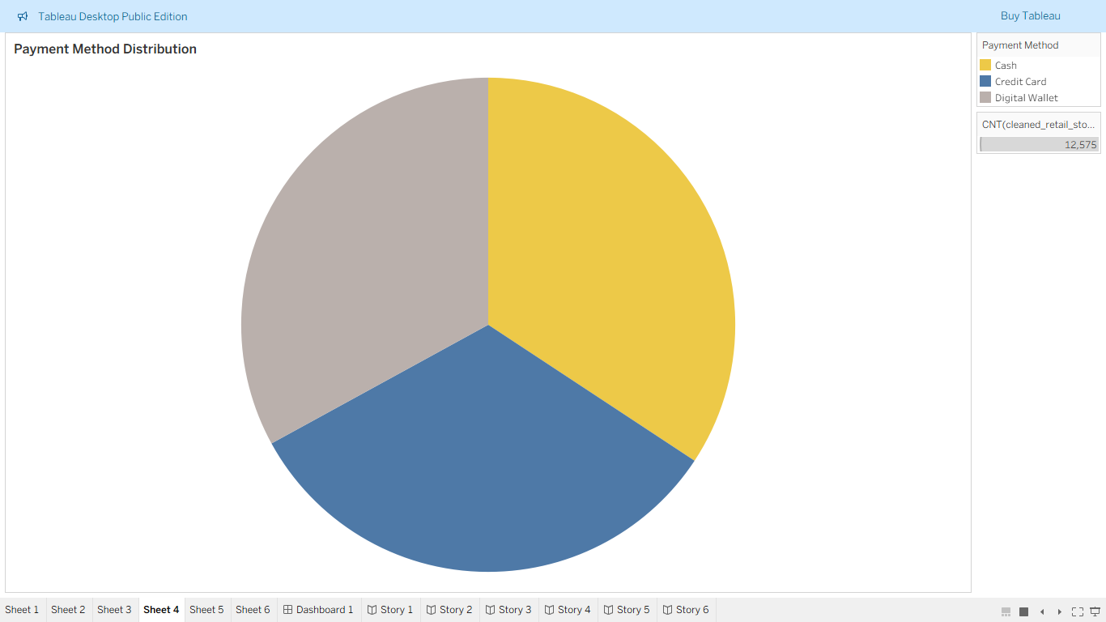

Slide 11
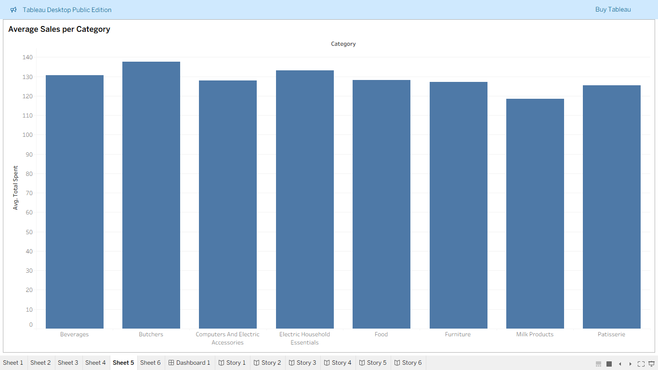

Slide 12
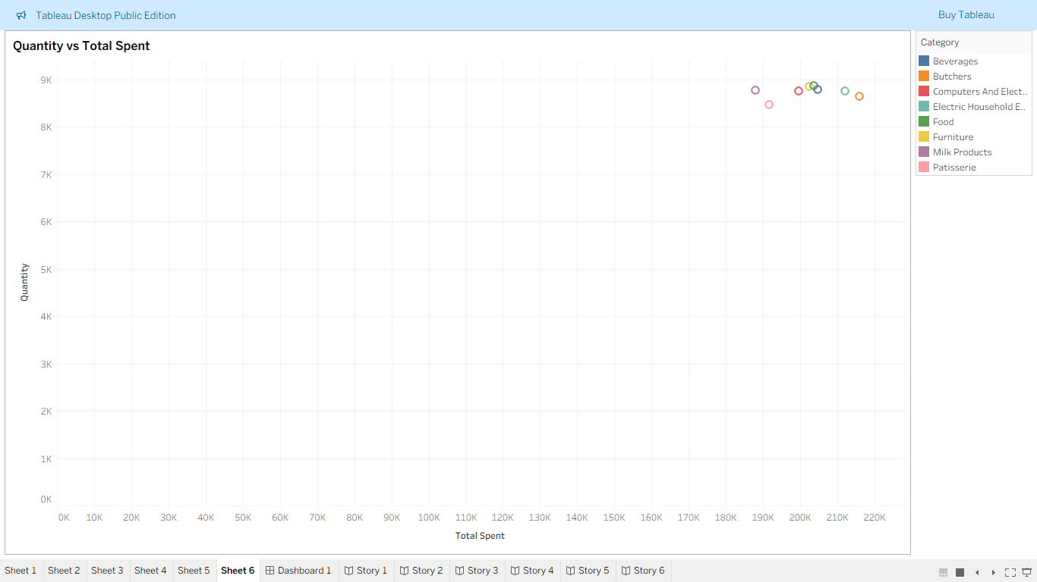

Slide 13
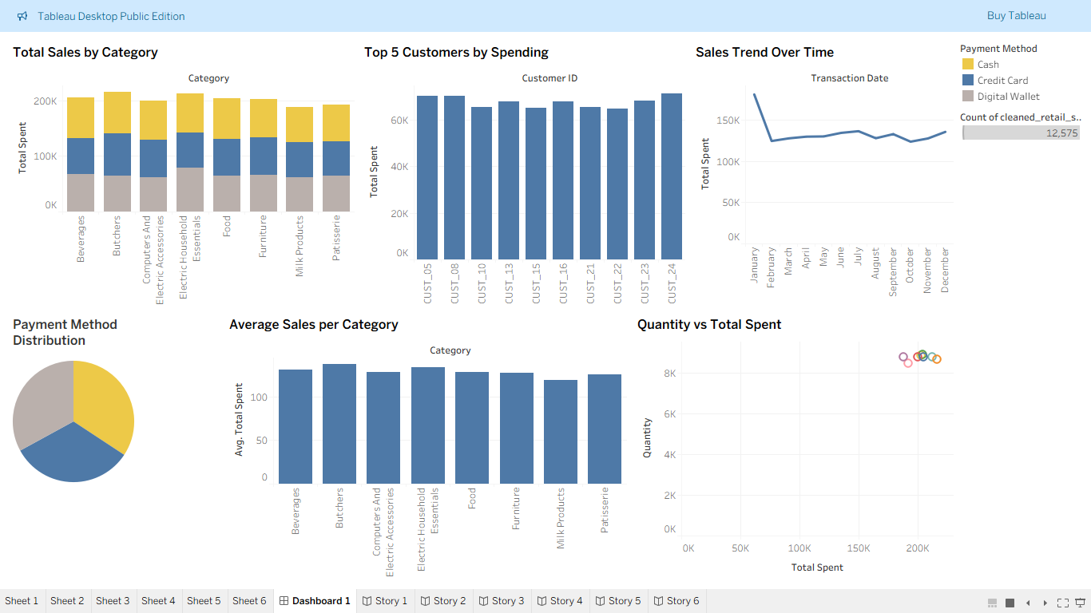

Slide 14
Insights
Butchers and Electronics have the highest sales. Milk Products and Patisserie are low — these can be improved by offers or discounts.
Top 5 customers spend the most and help the store earn more. They can be given loyalty rewards or early offers to keep them coming back.
Sales are high in January, go down mid-year, and rise again in December. This means sales increase during holidays and festivals.

Slide 15
Cash is the most used payment method in the store. Credit Card and Wallet payments are used less. The store can encourage digital payments by giving small cashback or discounts for online methods.
Electronics and Butchers have high average sales. Milk Products and Patisserie have small average amounts — maybe small daily items.
When customers buy more quantity, total spending also increases. The store can offer combo packs or “Buy 2 Get 1” offers to boost sales.

Slide 16
THANK YOU

